Slide 1
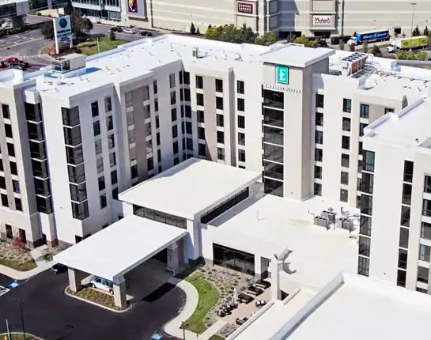
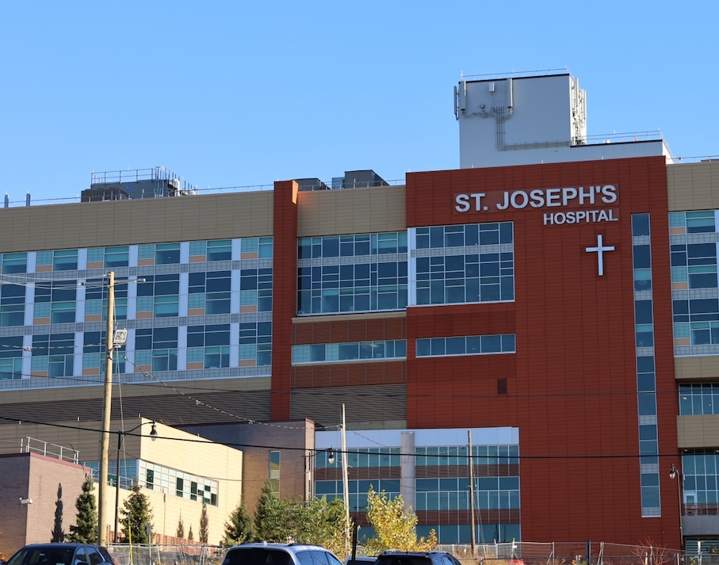
Mechanical Circulatory Support after Cardiac Surgery
Anton L Cherney MD FRCSC FACS
SJH Cardiovascular Symposium
5/16/2026

Slide 2

Post-Cardiotomy Cardiogenic Shock
Persistent shock despite maximal use of pharmacologic agents
Inability to separate from Cardiopulmonary Bypass
Infrequent problem that occurs in <4% of Adult patients undergoing Cardiac Surgery
Notes:
STS database

Slide 3
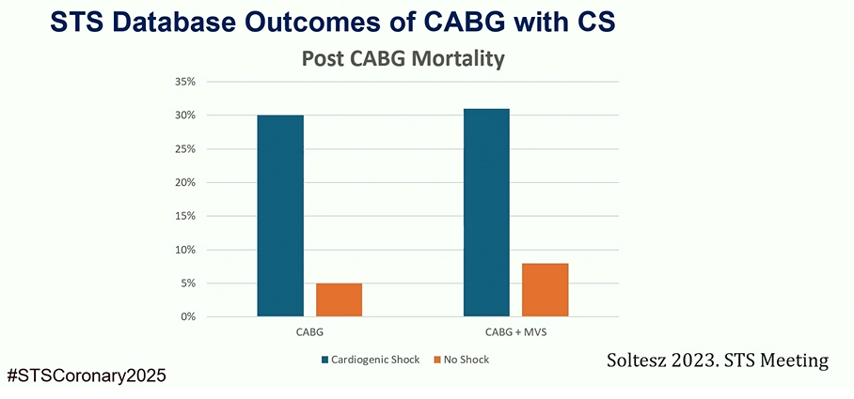
Magnitude of the problem

Slide 4
Decision to Initiate MCS post-op…
Often made at the end of a long complex case
Often Cardiac dysfunction is transient and will improve with time
MCS associated with multiple complications
_{Bleeding}
_{Embolic events}
Access complications (limb ischemia)
Notes:
Not easy decision!

Slide 5
Decision to Initiate MCS post-op…
Prolonged low output state will lead to Multi-Organ Failure
Waiting on CPB to make the decision has its own costs
  _{Bleeding}
  _{Vasoplegia}
Instituting MCS after transfer to CVICU often associated with significant delay
Notes:
Not easy decision!
Low flow state will lead to multi-organ failure
Cardiac arrest – Neurologic injury, bleeding with CPR

Slide 6
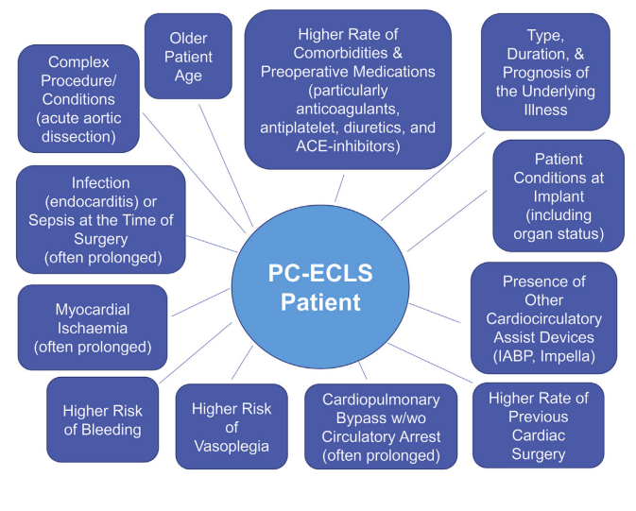
2020 EACTS/ELSO/STS/AATS Expert Consensus on Post-Cardiotomy Extracorporeal Life Support in Adult Patients
Notes:
2020 EACTS/ELSO/STS/AATS Expert Consensus on Post-Cardiotomy Extracorporeal Life Support in Adult Patients

Slide 7
Post-Cardiotomy Cardiogenic Shock
Can we predict which patient?
Valve surgery
Aortic surgery
Redo
Long complex operation
Decompensated CHF
End Organ dysfunction
Low systolic blood pressures and tachycardia
Poor mentation
AKI
Ischemic hepatitis
Notes:
Viability study – establish correlation between targets and viable myocardium

Slide 8
Post-Cardiotomy Cardiogenic Shock
Can we predict which patient?
Echo
LVEF <25%
Structural complications of completed MI: VSD LV Pseudoaneurysm
RV dysfunction
BiV dysfunction
Notes:
Viability study – establish correlation between targets and viable myocardium

Slide 9
Post-Cardiotomy Cardiogenic Shock
Can we predict which patient?
PA Cath
Low CI
Low PAPI, severe Pulmonary HTN
LHC
CABG: Bad targets, Bad conduits
Role of Viability study?
Notes:
Viability study – establish correlation between targets and viable myocardium

Slide 10
Which patients are candidates?
Age: No clear cutoff point
Comorbidities that will limit survival
Bridge to what?
  - Decision
  - Recovery
  - LVAD/Transplant

Slide 11
Which Device to use? At the time of surgery…
LV support
- IABP
- Impella 5.5 Axillary or Direct Aortic
Respiratory Failure/Pulmonary Edema
- VV ECMO IJ/Femoral or Dual Lumen
VA ECMO
- Central or Peripheral Cannulation
Notes:
Decision is between partial LV support (IABP), full LV support (I5.5), full Cardiopulmonary support, or Lung support
Use of IABP is mainly prophylactic, if someone is really struggling to wean IABP will usually be insufficient
Often lowest output state 6-12 hours post-op, as vasoplegia resolves
Unplanned post-op MCS is usually VA ECMO!
Impella 5.5 is either planned pre-op, or added to VA ECMO later
Placing Impella 5.5 intra-op risks lateral wall perforation!
Close chest whenever possible to reduce risk of bleeding and infection
Central ECMO may be considered when not possible to close chest (bleeding, edema)

Slide 12
Which Device to use? After Surgery…
LV support
- IABP
- Impella 5.5 – Axillary
RV Support
- Impella RP
- ProtekDuo
VV ECMO
VA ECMO

Slide 13
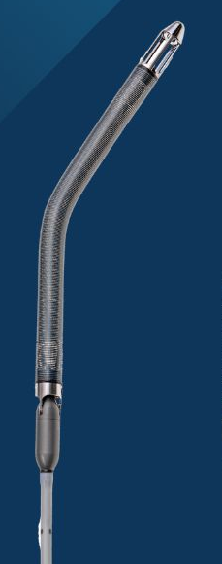
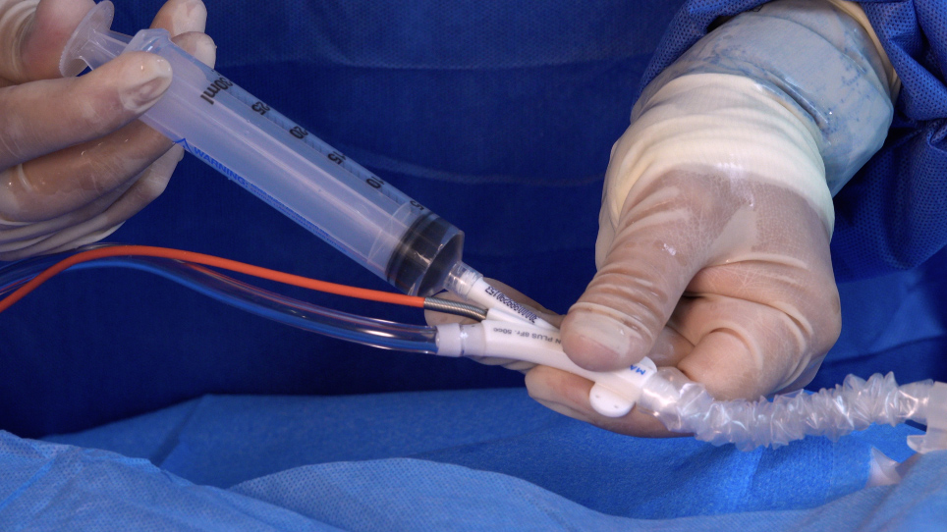
Which Device to use?

Slide 14
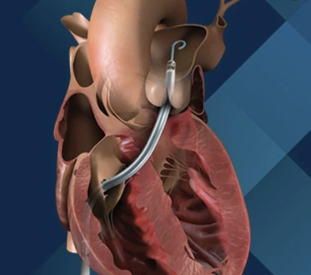
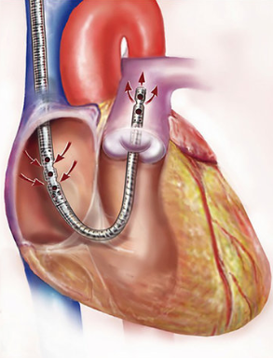
Which Device to use?

Slide 15
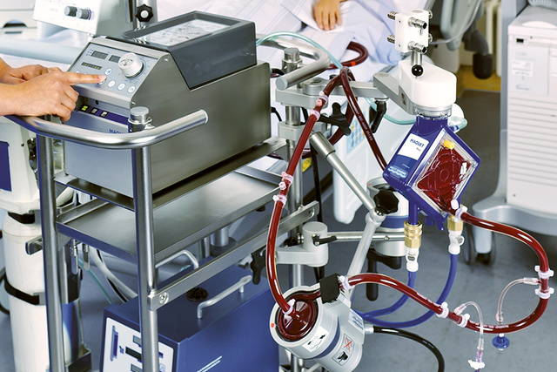
Which Device to use?

Slide 16
Post-op Issues: VA ECMO
Bleeding vs Thrombosis
- Systemic Embolic Events
- Aortic Root Thrombosis
- Oxygenator, Cannula, CRRT Filter
- HIT Syndrome
Timing of Anticoagulation? Heparin vs Bival?
Limb Ischemia
  - Distal Perfusion Catheter
  - 15 Fr Arterial Cannula
Notes:
Every VA ECMO must have distal perfusion catheter
6 French sheath in SFA
Micropuncture in DP
Added to the circuit in OR or CVICU

Slide 17
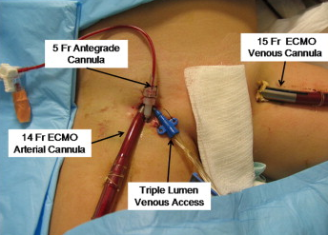
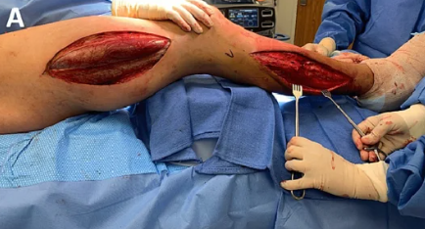
Post-op Issues: Limb Ischemia
Delay in distal limb perfusion will lead to ischemia and compartment syndrome!

Slide 18
Post-op Issues: VA ECMO
LV distention
  - LV Vent
  - Impella CP or 5.5
Upper body Hypoxemia
  - VAV ECMO with IJ Perfusion cannula
Notes:
Upper body Hypoxemia occurs with significant LV output but failure to oxygenate

Slide 19
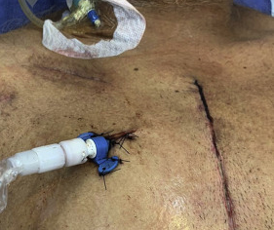
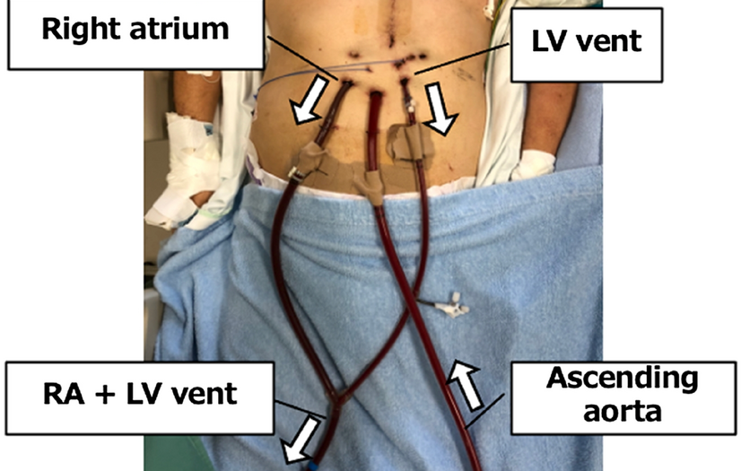
Post-op Issues: LV Distension
Notes:
Upper body Hypoxemia occurs with significant LV output but failure to oxygenate

Slide 20
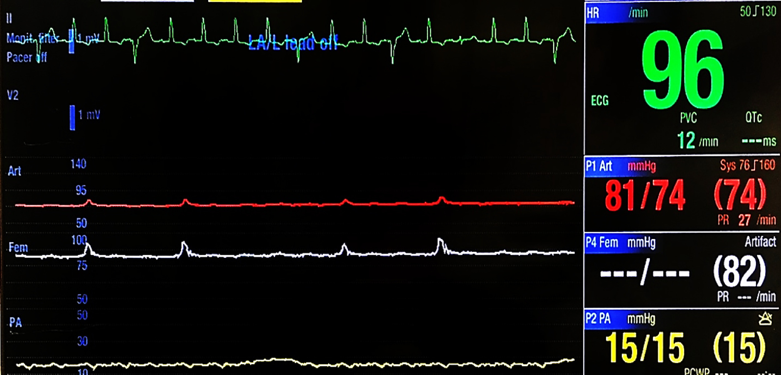
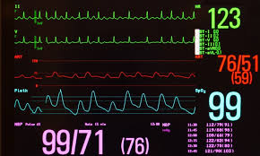
LV Distension vs Upper Body Hypoxemia
Notes:
Upper body Hypoxemia occurs with significant LV output but failure to oxygenate

Slide 21
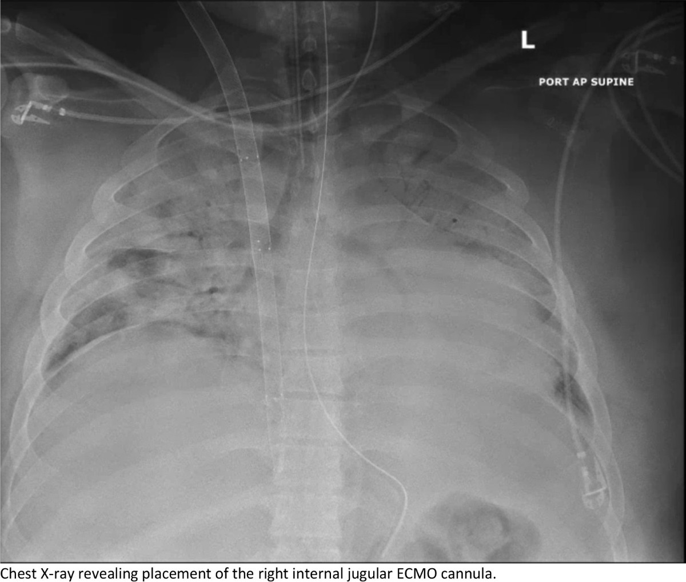
Upper Body Hypoxemia
Notes:
Upper body Hypoxemia occurs with significant LV output but failure to oxygenate

Slide 22
VA ECMO: Weaning Strategies
Decannulate
Add Impella 5.5 to ECMO
  Helps with LV distention
  Aortic root thrombosis
  Bridge to weaning ECMO
Transition VA ECMO to VAV ECMO to VV ECMO
  Treat upper body Hypoxemia
  Pulmonary vasodilation with decrease RV afterload
Add RV Support Device
  Impella RP
  ProTekDuo
Notes:
Upper body Hypoxemia occurs with significant LV output but failure to oxygenate

Slide 23
Case of Post-op MCS #1
48 yoM
2006 Mechanical MVR Right Thoracotomy
Issues with EtOH use and non-compliance
2013 admitted with CHF, Mitral leaflet Thrombosis
2013 Redo Right Thoracotomy Redo MVR 25 Mosaic

Slide 24
Case of Post-op MCS #1
Presented 2/13 this year in CHF – severe Mitral Stenosis
LHC with single vessel LAD disease
2/23 TMVR converted to Sternotomy
  MVR 27 Mosaic, CABG1 SVG-LAD, Left Femoral VA ECMO
2/24 Exploration for bleeding

Slide 25
Which Device to use?
Post-op…
Notes:
Upper body Hypoxemia occurs with significant LV output but failure to oxygenate

Slide 26
Case of Post-op MCS #1
  Options to transition from VA ECMO after adequate LV recovery?
  VA ECMO VAV ECMO VV ECMO
  VA ECMO RVAD with Oxygenator
  VA ECMO RP Impella
  VA ECMO Decannulate?

Slide 27
Case of Post-op MCS #1
3/3 Placement of ProtekDuo via Right IJ, Removal of femoral VA ECMO cannulas
Pulmonary Hemorrhage requiring multiple bronchoscopies, white-out on CXR – gradually improved
3/6 Percutaneous Tracheostomy

Slide 28
Case of Post-op MCS #1
ProTekDuo removed 3/19 at bedside CVICU
Renal failure CRRT transitioned to IHD
Improving Respiratory Failure
Trach decannulated 4/13
Discharged to Rehab 4/22

Slide 29
Case of Post-op MCS #2
66 yoM Patient with CAD, Aortic Root Aneurysm
Hx of HTN, HLD, DM2, PAD s/p multiple Vascular surgeries, OSA
Sep 2024 David VSRR Procedure with 34 mm Hemashield Graft and CABG3 with LIMA/SVG
Notes:
Vascular Hx: Fem-Fem, Right Fem-Pop, Left-Fem-Tib bypasses
We thought he was going to live happily ever after!

Slide 30
Case of Post-op MCS #2
Admitted to Upstate Nov 2025 with MCA stroke, MSSA Bacteremia, underwent Catheter thrombectomy
Native Aortic Valve Endocarditis on TEE - managed medically
Admitted SJH Jan 2026 with CHF, Severe AI and Aortic Root Abscess

Slide 31
Case of Post-op MCS #2
2/18/2026 Redo Sternotomy
Right Axillary Arterial and Femoral Venous Cannulation
Intra-op Type A Aortic Dissection
Both Femoral Arteries too diseased to cannulate!
Notes:
Mediastinal dissection very difficult – dense adhesions with no tissue planes
With initiation of CPB Left arterial line reading very low pressures, IMH and then intimal flap visualized in Aortic Arch on TEE
Flow 2-3 L/min with normal Cerebral Oximetry
Epiaortic US of the Ascending Aorta performed and True lumen cannulated with second cannula which was connected to CPB circuit

Slide 32
Case of Post-op MCS #2
Second Arterial cannula placed into Ascending Aorta true lumen under US
DHCA and replacement of Ascending Aorta with 32 mm Hemashield Graft
AVR with 27 Edwards Magna, Bovine Pericardial patch of Aortic Annulus
Peri-Aortic to Right Atrium Baffle constructed to control bleeding
Notes:
With initiation of CPB Left arterial line reading very low pressures, IMH and then intimal flap visualized in Aortic Arch on TEE
Flow 2-3 L/min with normal Cerebral Oximetry
Epiaortic US of the Ascending Aorta performed and True lumen cannulated with second cannula which was connected to CPB circuit

Slide 33
Case of Post-op MCS #2
Unable to come off Bypass due to Hemodynamic instability and inability to Oxygenate
Neither femoral artery amenable to cannulation due to severe PAD
Right Axillary artery site of Dissection
How to Support??
Notes:
Fem-Fem, Right Fem-Pop, Left-Fem-Tib bypasses

Slide 34
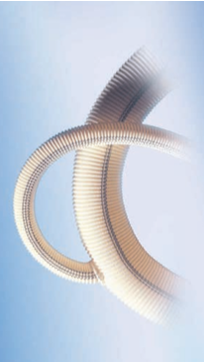
Case of Post-op MCS #2
Ascending Aortic Hemashield graft cannulated through 10 mm side arm
Cannula brought out through incision in Baffle and exteriorized through Right axillary incision
Re-explored for bleeding, chest left open
Notes:
Fem-Fem, Right Fem-Pop, Left-Fem-Tib bypasses

Slide 35
Case of Post-op MCS #2
Hemodynamics, bleeding improved over the next 48 hours
2/20 VA ECMO removed, chest closed
Respiratory failure requiring Tracheostomy 2/26
Recurrent Pleural effusions – bilateral PleurX
Transthoracic Echo 3/16 shows Anterior and Apical RWMA
LHC 3/17 – occluded LIMA, PCI to LAD
Notes:
Neuro Intact

Slide 36
Case of Post-op MCS #2
Weaned from Vent support and decannulated 3/22
AKI – resolved
Sacral decubitus ulcer requiring wound VAC
Passed swallow eval for Modified diet but caloric intake deemed inadequate, PEG placed 4/9
Discharged to Rehab to 4/17 (POD#58)
Notes:
Neuro Intact

Slide 37
Conclusion
MCS is a set of very important tools for taking care of most complex patients in Cardiac Surgery
Decisions to institute MCS, type of MCS, timing of initiation, have great impact on patient survival
MCS can be life saving but comes with its own unique sets of problems and complications!

