Slide 1
Percutaneous Therapies of Mitral Insufficiency
Ziad El-Khally , MD
Director Interventional Cardiology. Structural Heart Disease
Saint Joseph Hospital

Slide 2
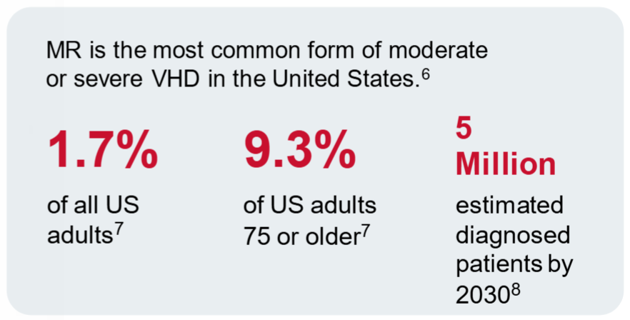
Prevalence

Slide 3
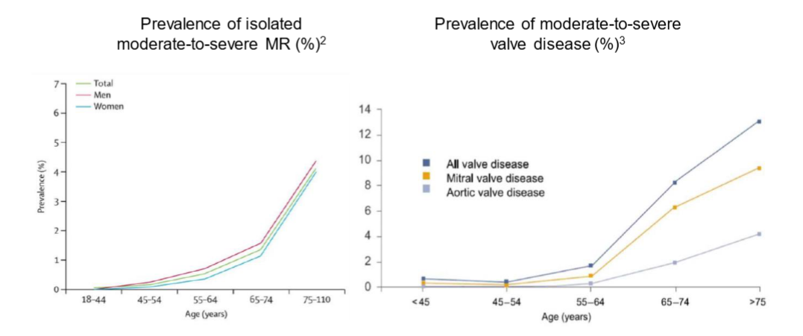
Prevalence in older population

Slide 4
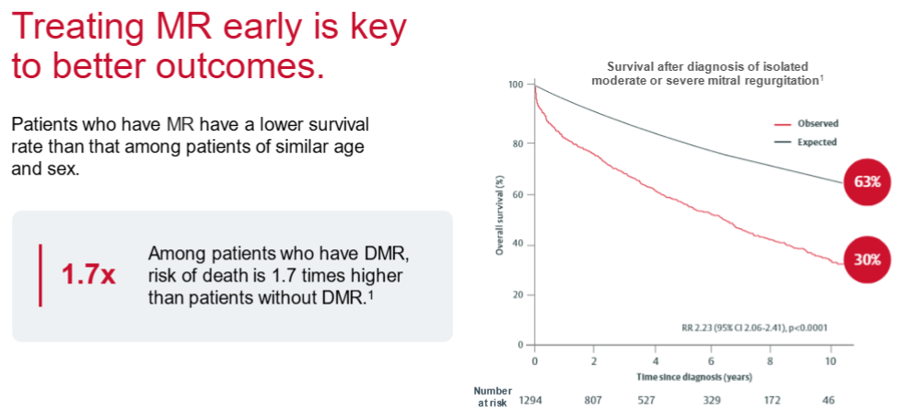
Effect on Survival

Slide 5
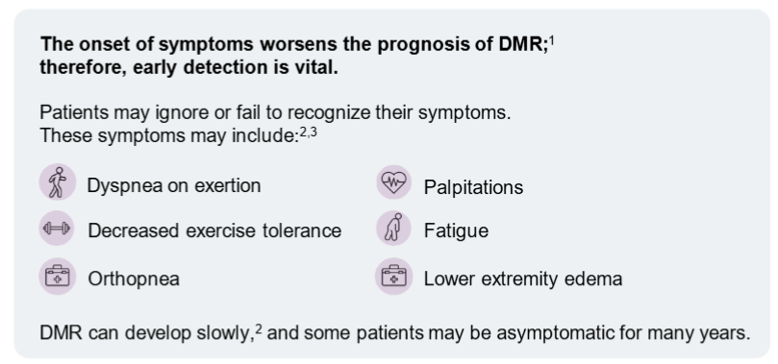
Early Detection is Vital

Slide 6
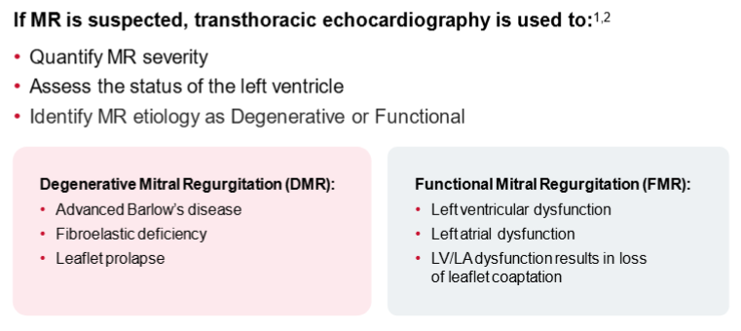
Early Detection is Vital

Slide 7
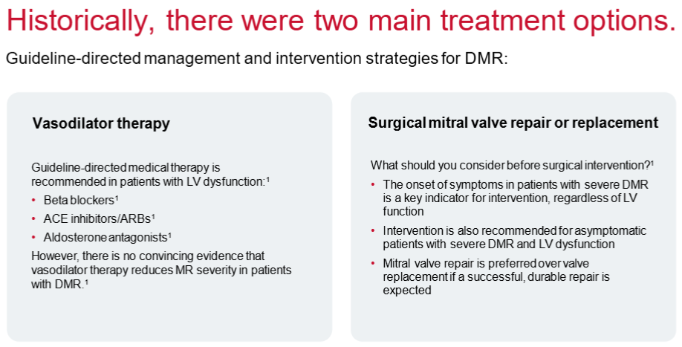
Treatment options

Slide 8

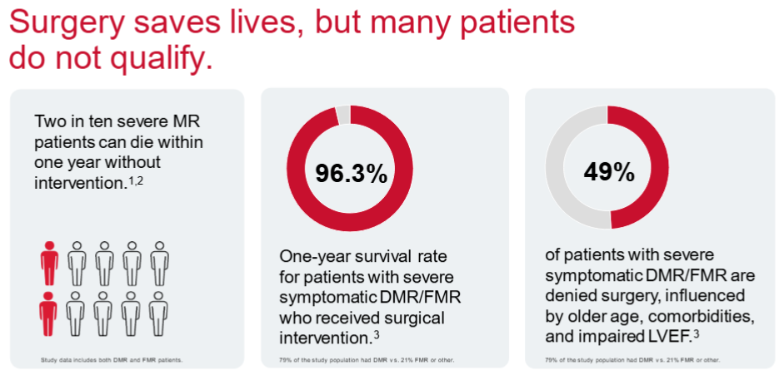
MR is undertreated

Slide 9
Case Study 1

Slide 10
MW is a 51-year-old woman with history of smoking and COPD admitted to the hospital with acute heart and respiratory failure.
Patient was recently admitted to another Hospital for worsening shortness of breath. She was transferred to ICU for pneumonia and respiratory failure. She was discharged home on 4/11/2025.
Readmitted on 4/22 for worsening SOB and orthopnea.
CTA showed No evidence of acute pulmonary embolism and small dependent bilateral pleural effusions without evidence of pneumonia and without active pulmonary edema despite multichamber prominence in size of the heart the heart.
Cath showed no CAD.

Slide 11
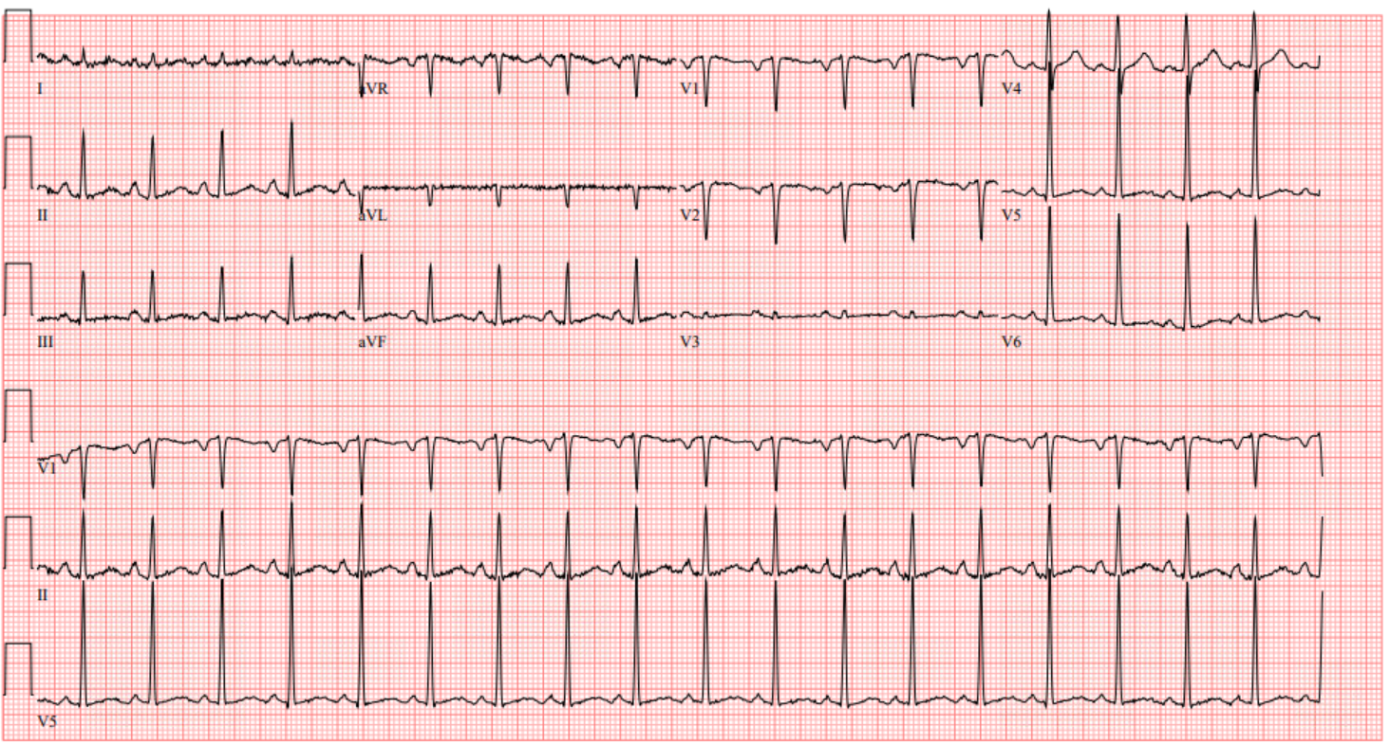
EKG

Slide 12
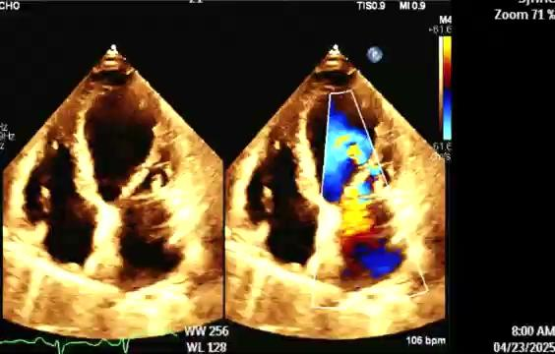
Baseline TTE

Slide 13
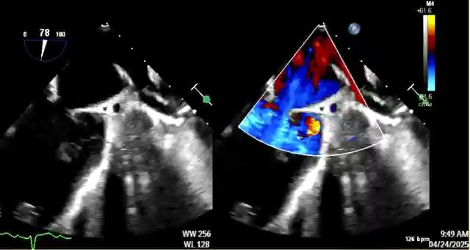
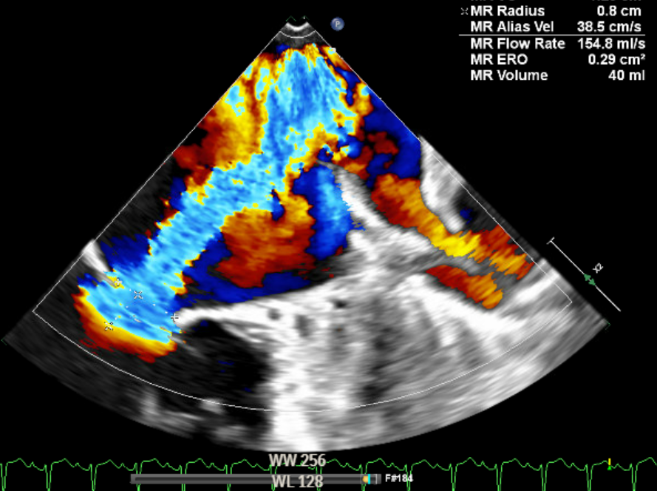
Baseline TEE

Slide 14
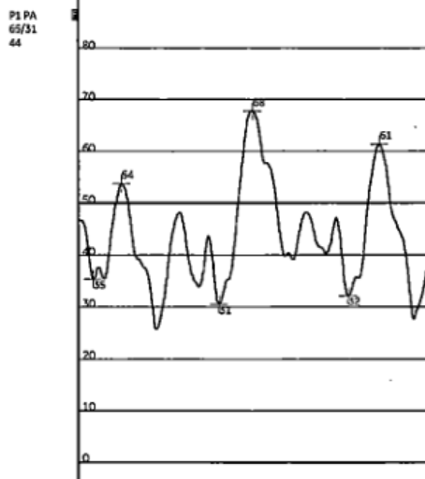
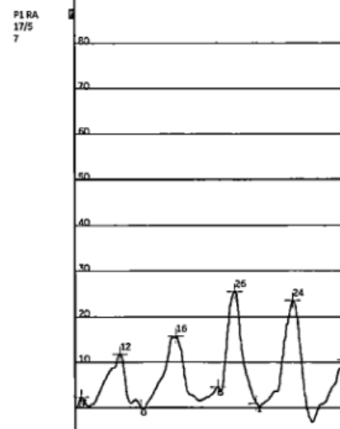
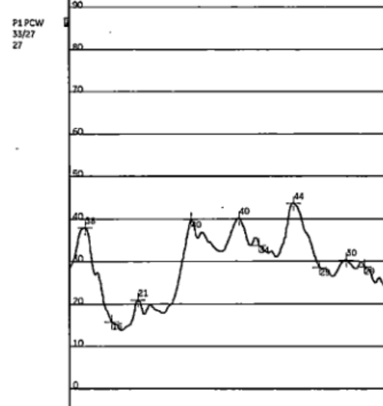
Cath and Hemodynamics

Slide 15
Options
Medical therapy
Surgical Mitral Valve Replacement
Surgical Mitral Valve Repair
Transcatheter Edge to Edge Repair (TEER)
Transcatheter Mitral Valve Replacement

Slide 16
Hospital Course
Improved with diuresis.
GDMT started (Lasix, digoxin, Toprol, Entresto)
Surgical consult obtained and recommended TEER due to LV dysfunction and lung status.
Discharged for follow up with structural IC.

Slide 17
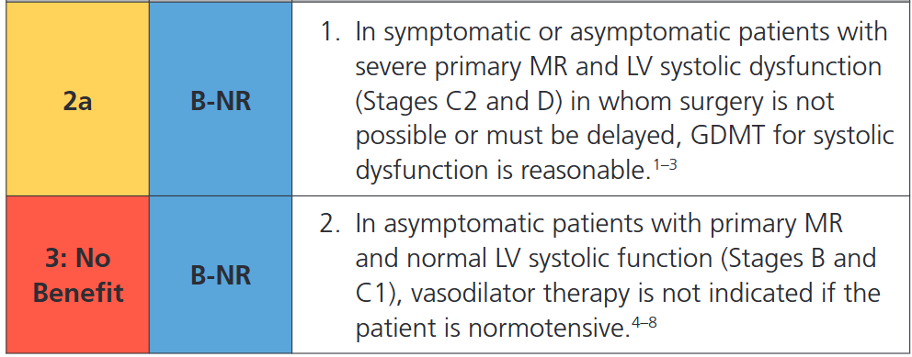
2020 ACC/AHA Guideline for the Management of Patients With Valvular Heart Disease
Medical Therapy.

Slide 18
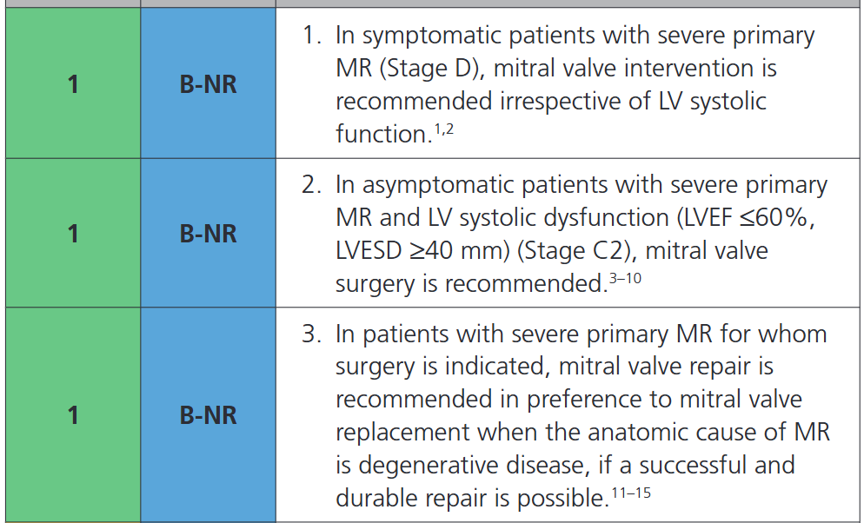
2020 ACC/AHA Guideline for the Management of Patients With Valvular Heart Disease
B. Intervention.

Slide 19
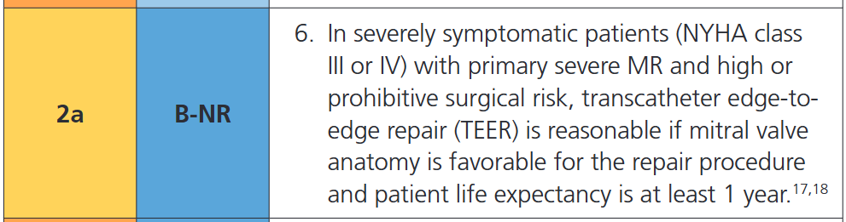
2020 ACC/AHA Guideline for the Management of Patients With Valvular Heart Disease
B. TEER.

Slide 20
Structural IC follow up (one month later)
At this time she feels fairly asymptomatic with good exercise tolerance. I would recommend to repeat the echocardiogram now that she is on guideline directed medical therapy. Depending on the data from the echocardiogram she may be continued with guideline directed medical therapy only or referred to surgery again for surgical risk assessment and consideration of surgical mitral valve repair or replacement. If she is again felt to be high risk for surgery she will be referred to the structural clinic for consideration of TEER.

Slide 21
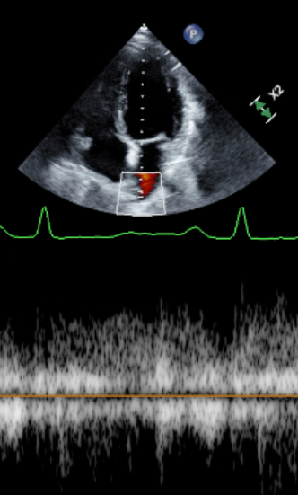
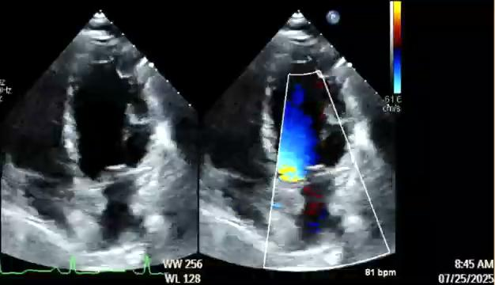
Three months Echo follow up

Slide 22
In acutely decompensated patients (AFib/RVR, acute CMP etc…) complicated by significant SECONDARY mitral insufficiency and who are able to be stabilized medically, a trial of GDMT and underlying cause treatment (cardioversion, revascularization etc…) is reasonable prior to reassessing the severity of mitral insufficiency and committing to mitral valve intervention.

Slide 23
Case Study 2

Slide 24
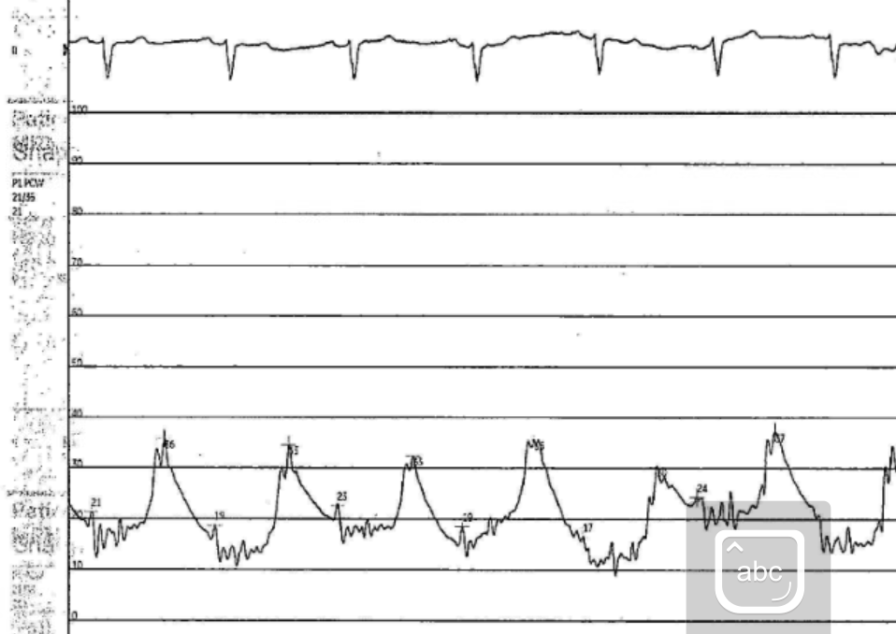
HL is an 80 yo female with Mitral valve stenosis s/p robotic MV repair in 2013 requiring replacement in the same year due to stenosis, redo MV replacement in 2018 due to endocarditis also had TVR, s/p mitral PVL closure at the Cleveland clinic in 2023

Slide 25
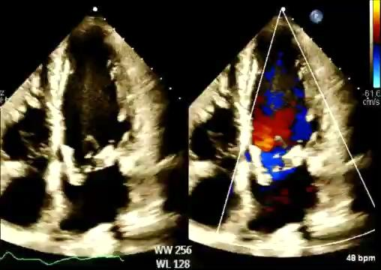
Baseline TTE

Slide 26
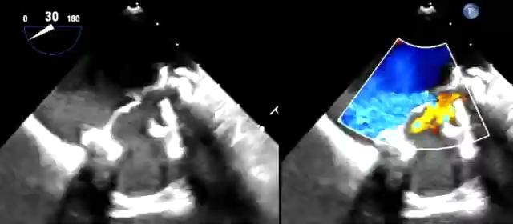
Baseline TEE

Slide 27
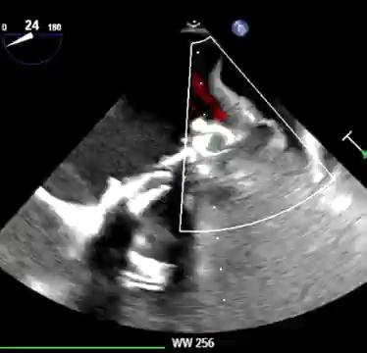
Baseline TEE

Slide 28
Options
Medical therapy
Surgical Mitral Valve Replacement
Surgical Mitral Valve Repair
Transcatheter Edge to Edge Repair (TEER)
Transcatheter Mitral Valve Replacement

Slide 29
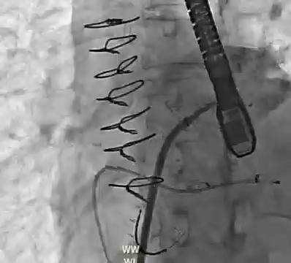
TMVR: Set up

Slide 30
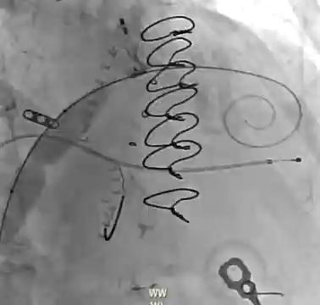
TMVR: SEPTOPLASTY

Slide 31
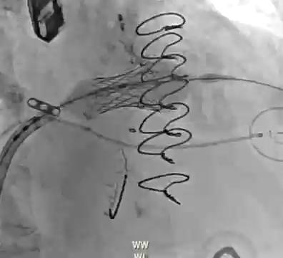
TMVR: VIV

Slide 32
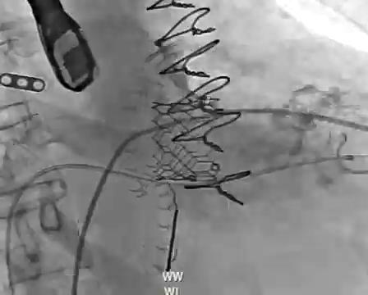
TMVR: Post assessment

Slide 33
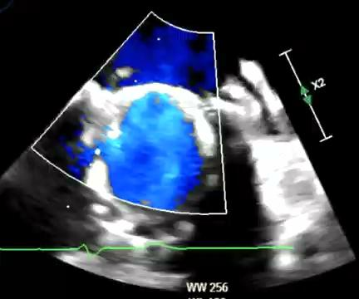
TMVR: Post assessment TEE

Slide 34
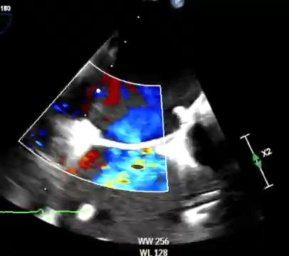
TMVR: Post assessment TEE

Slide 35
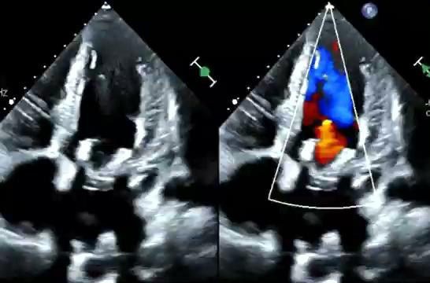
TMVR: Post assessment TTE

Slide 36
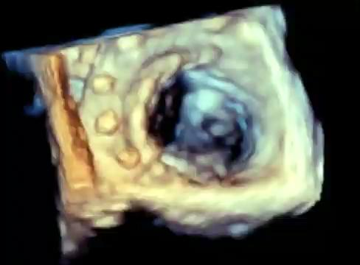
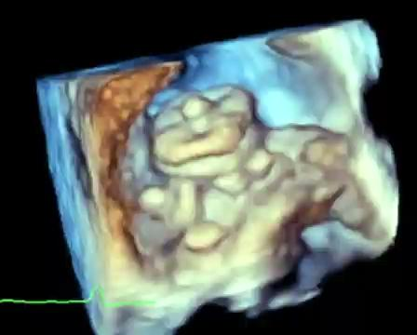
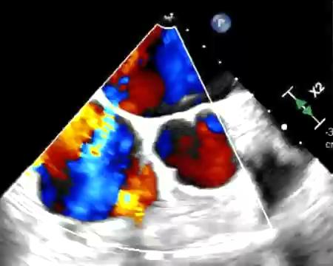
TMVR: One year post TEE

Slide 37
Case Study 3

Slide 38
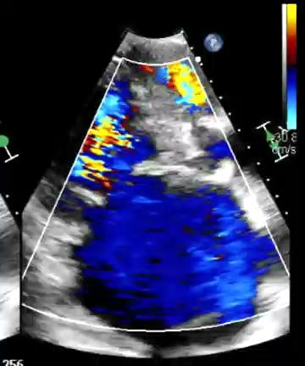
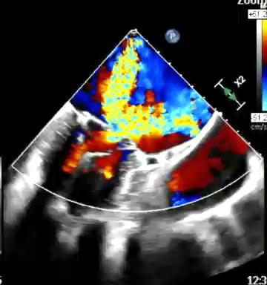
EG is an 88-year-old woman with atrial fibrillation and severe mitral insufficiency and renal insufficiency who had multiple recent admissions for acute heart failure complicated by acute respiratory failure and one instance of cardiac and respiratory arrest. She has no coronary artery disease. She was referred for a transcatheter mitral edge-to-edge repair procedure with mitral clip placement.

Slide 39
Options
Medical therapy
Surgical Mitral Valve Replacement
Surgical Mitral Valve Repair
Transcatheter Edge to Edge Repair (TEER)
Transcatheter Mitral Valve Replacement

Slide 40
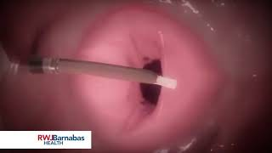
TEER

Slide 41
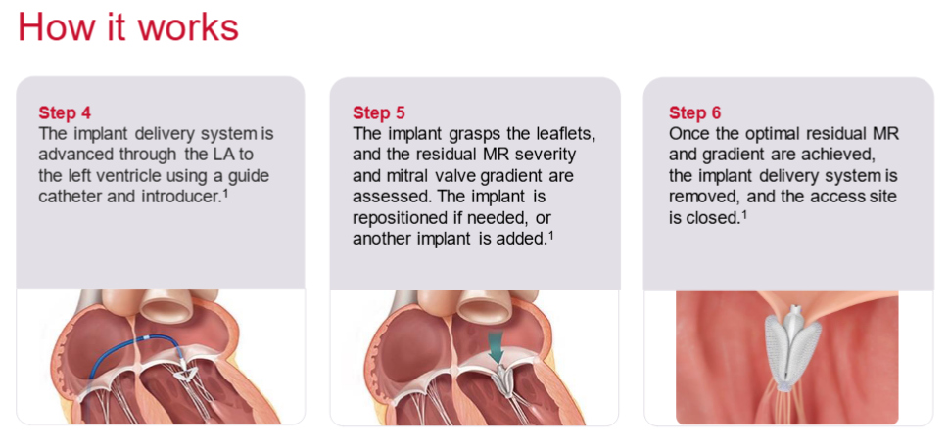
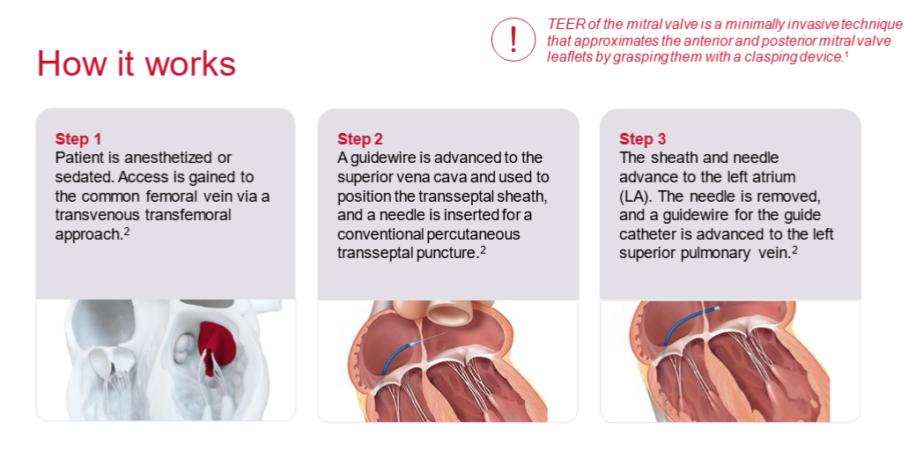
TEER

Slide 42
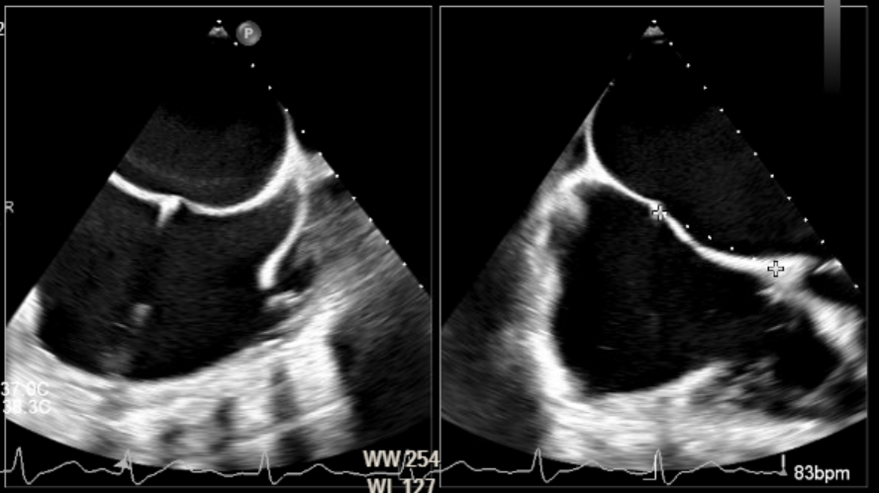
TEER: Set up (transseptal puncture)

Slide 43
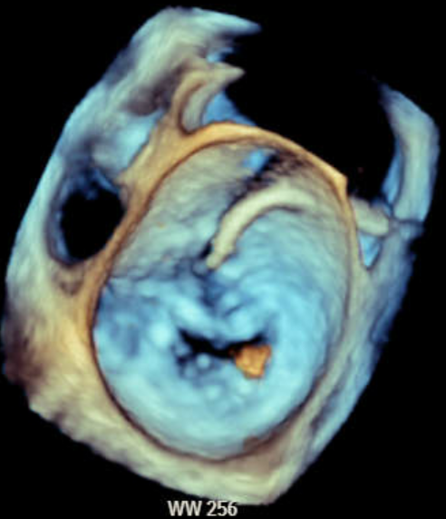
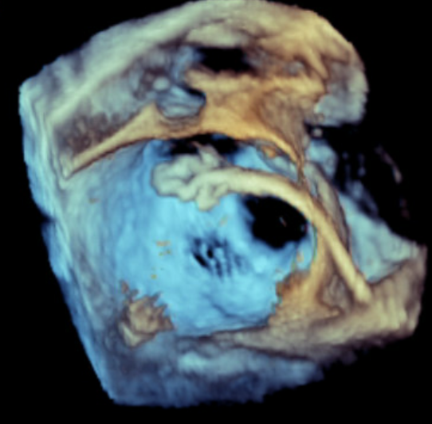
TEER: Procedure guidance TEE

Slide 44
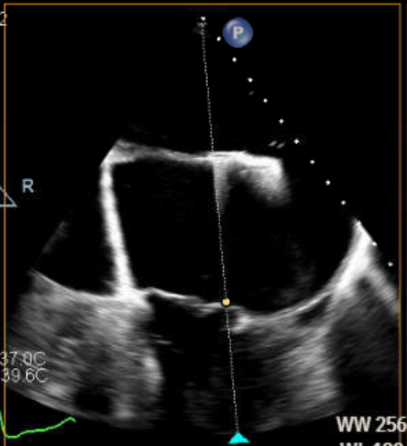
TEER: Procedure Sequence (Atrial staging)

Slide 45
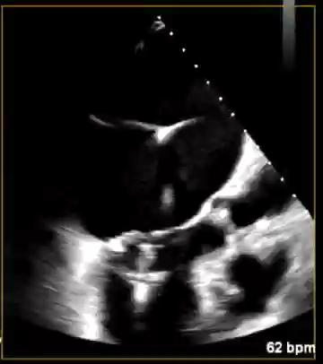
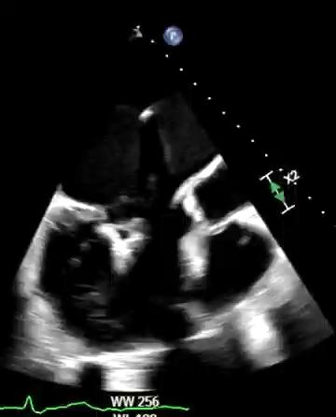
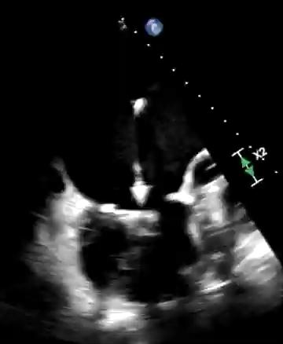
TEER: Procedure Sequence (ventricular grasp)

Slide 46
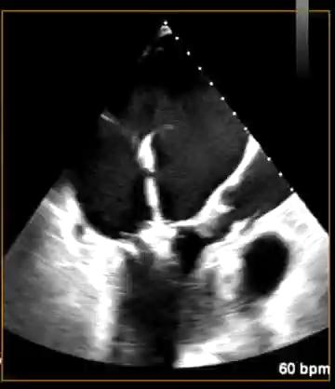
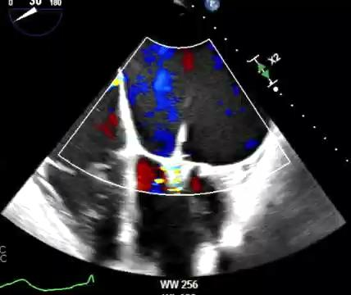
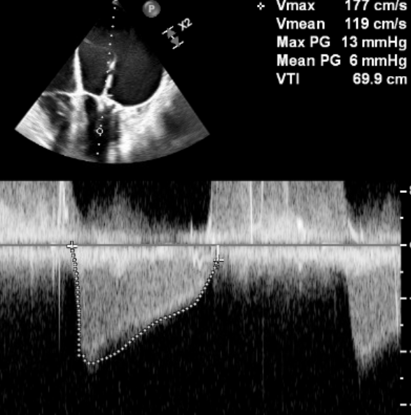
TEER: Immediate post-procedure assessment

Slide 47
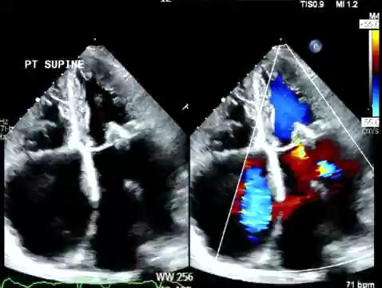
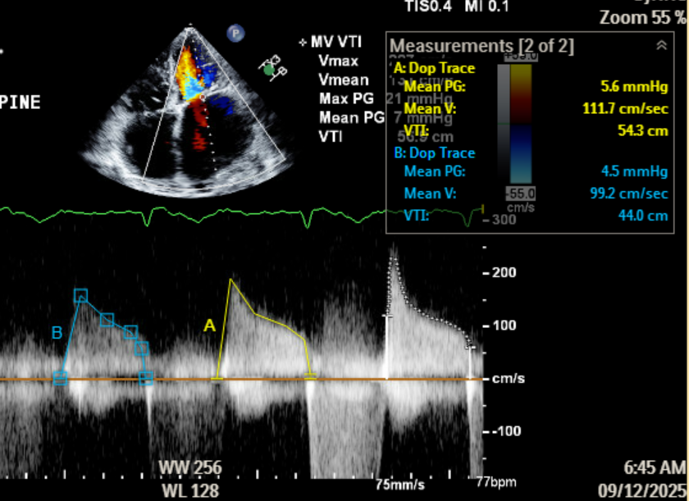
The day after

Slide 48
Case Study 4

Slide 49

HK: pre and post TEE

Slide 50


HK: pre and post hemodynamics

Slide 51

TEER Benefits

Slide 52
Our current TEER program (Last Quarter)
n= 8
Age 72 - 88 (mean 81.3)
STS score 8.08 - 44 (mean 15.1)
EF 35 - 65% ( median 50)
PAP 35 - 110 ( mean 57)
Procedure time mean 98 min
Device time mean 81 min
Number of clips 1-2
LA pre 18 - 60 ( mean 33)
LA post 8 - 18 (mean 13)
MV mean gradient post 2 - 6 (median 4)
Procedural success 100%
LOS post 1 -8 days (mean 3.75, median 1)

Slide 53
NEW FRONTIER TMV REPLACEMENT
THE M3 VALVE in NATIVE

Slide 54


